Slide 1
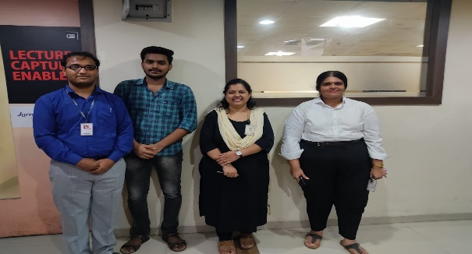
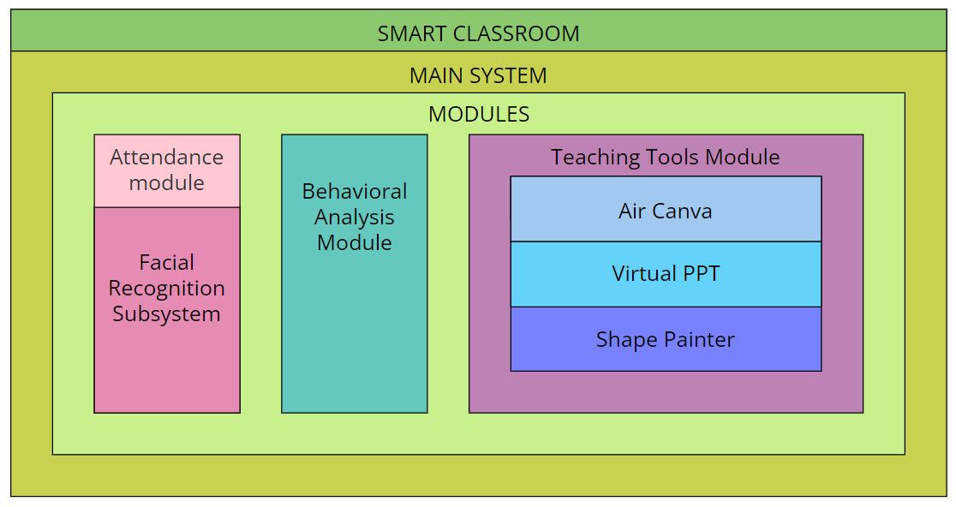
Department : Computer Engineering
Project Title : SMART CLASSROOM
Domain : An application of Computer Vision
Name of Project Guide : Prof. Sneha Annappanavar (sneha.annappanavar@vit.edu.in)
Name of Students : Siddhesh Varpe (siddhesh.varpe@vit.edu.in)
Abhishek Yadav (abhishek.yadav@vit.edu.in)
Swathy Ayyangar (swathy.ayyangar@vit.edu.in)
Brief idea of Project :
In the contemporary landscape of education, technology has emerged as a powerful force, promising to reshape the way we teach and learn. This project proposes a comprehensive framework for the development of a smart classroom environment, leveraging various technological modules to address the shortcomings of traditional teaching methods.
Working of Project:
Application:
Creating an iteractive classroom environment to increase student engagement in classroom activities.

